Slide 1
Unit - III Hash Tables
Course Code: 21AI33

Slide 2
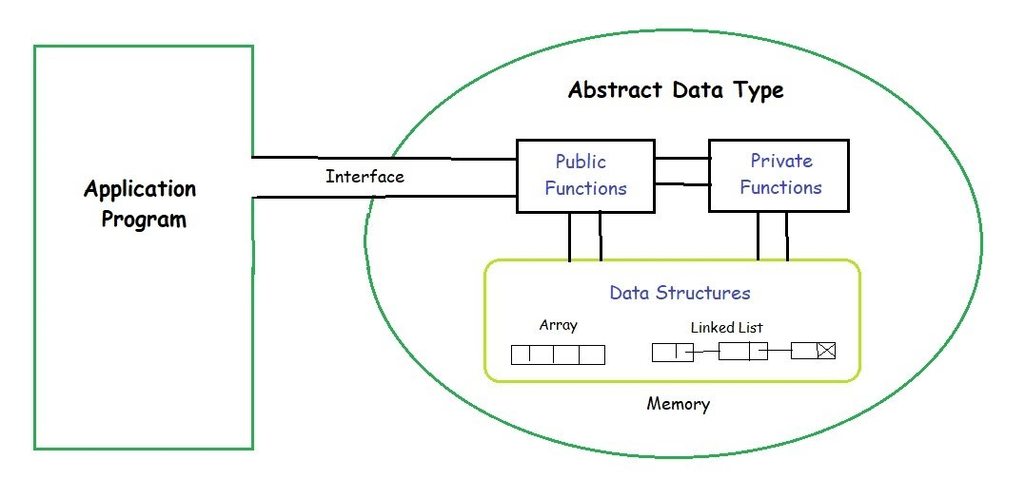
Abstract Data Types (ADTs)
Data and Operations are binded
The definition of ADT only mentions what operations are to be performed but not how these operations will be implemented.
It does not specify how data will be organized in memory and what algorithms will be used for implementing the operations.
It is called “abstract” because it gives an implementation-independent view.
Examples: List ADT, Stack ADT, Queue ADT, Vectors, Maps, Sets, etc.

Slide 3
Abstract Data Types (ADTs)
ADT has three components:
A name
A set of required operations (with contracts)
A set of expected properties
ADT Name: Set
ADT operations:
addElt : Set element -> Set
remElt : Set element -> Set
size : Set -> integer
hasElt : Set element -> boolean
ADT properties (vague):
1. The set has no duplicates
2. The items within the set are unordered

Slide 4
Set ADT (Abstract Data Type)
A set is an abstract data type that can store unique values, without any particular order
Maintains a set S under the following three operations:
1. Insert(x): Add the key x to the set.
2. Delete(x): Remove the key x from the set.
3. Search(x): Determine if x is contained in the set, and if so, return a pointer to x.
Hash Tables are used to implement set ADT

Slide 5
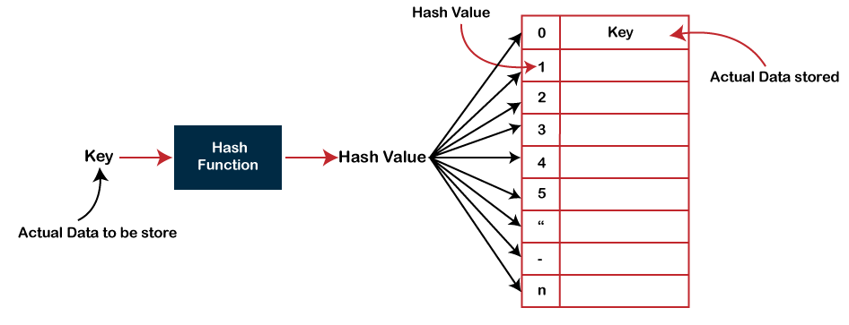
Hash Tables Basics
A hash table is a data structure that is used to store keys/value pairs.
It uses a hash function to compute an index into an array in which an element will be inserted or searched.
Under reasonable assumptions, the average time required to search for an element in a hash table is O(1).

Slide 6
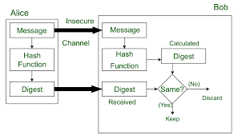
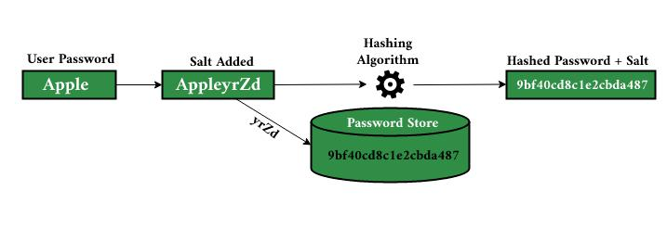
Hash Tables Applications
Creating Message Digests in Cryptography
Password Verification

Slide 7
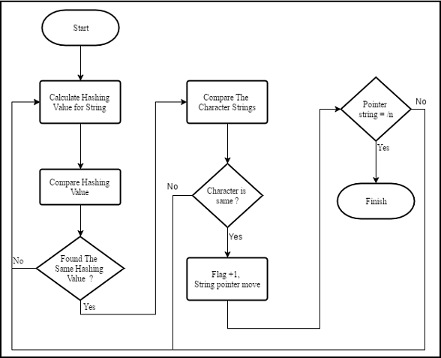
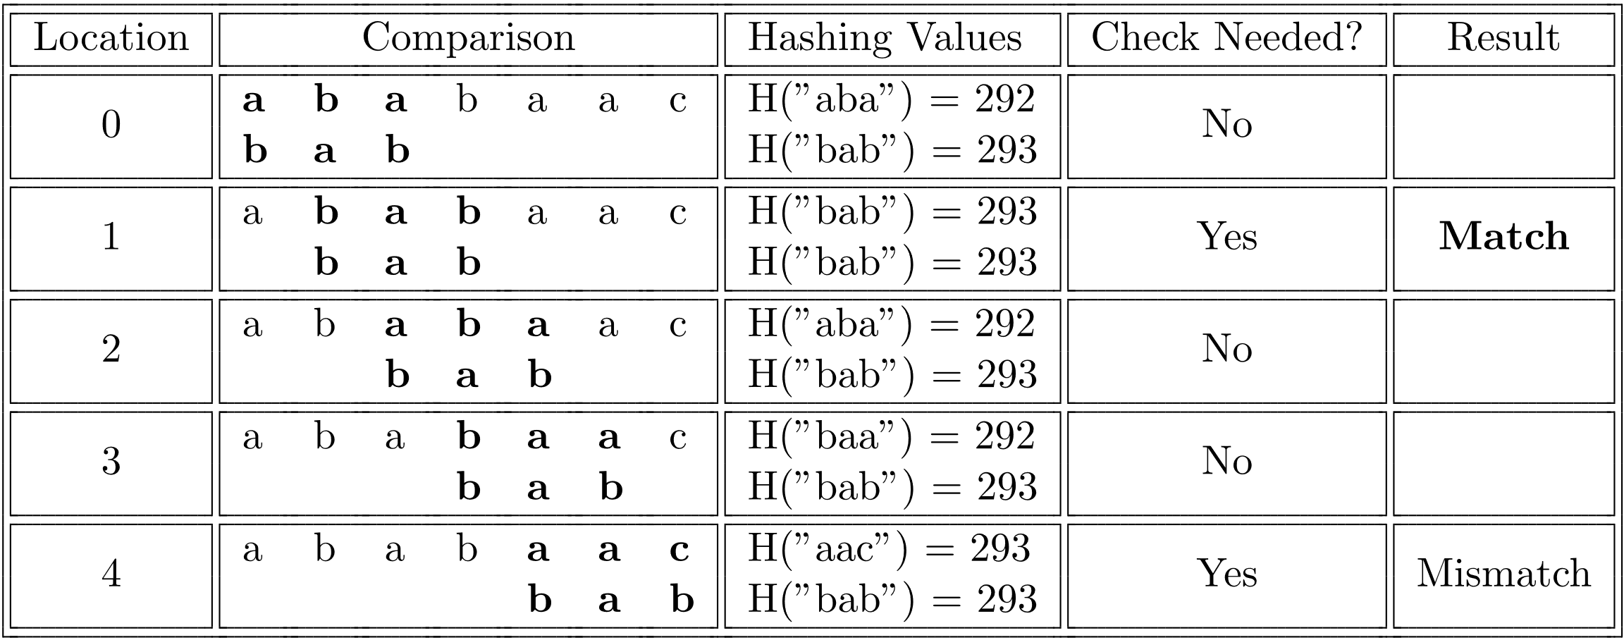
Hash Tables Applications
Rabin Karp Algorithm (Plagiarism Checking)

Slide 8
Integer Universe assumption
All elements stored in the hash table come from the universe U = {0, . . . , u−1}.
The goal is to design a hash function
h : U → {0, . . .,m − 1} so that for each i ∈ {0, . . .,m − 1}, the number of elements x ∈ S such that h(x) = i is as small as possible.
Ideally, the hash function h would be such that each element of S is mapped to a unique value in {0, . . .,m−1}.

Slide 9
Random Probing assumption
Each element x that is inserted into a hash table is a black box that comes with an infinite random probe sequence x0, x1, x2, . . .
where each of the xi is independently and uniformly distributed in {0, . . .,m − 1}.

Slide 10
Hash Tables for Integer Keys
A hash function h is a function whose domain is U and whose range is the set {0, . . .,m − 1}, m ≤ u.; key values x come from the universe U = {0, . . . , u − 1}.
A hash function h is said to be a perfect hash function for a set S ⊆ U if, for every x ∈ S, h(x) is unique.
A perfect hash function h for S is minimal if m = |S|, i.e., h is a bijection between S and {0, . . .,m − 1}.
A minimal perfect hash function for S is desirable since it allows us to store all the elements of S in a single array of length n.

Slide 11
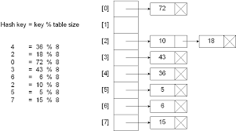
Hashing by Division
In hashing by division, we use the hash function
h(x) = x mod m .
To use this hash function in a data structure, we maintain an array A[0], . . .,A[m−1] where each element of this array is a pointer to the head of a linked list.
The linked list Li pointed to by the array element A[i] contains all the elements x such that h(x) = i.

Slide 12
Hashing by Division
If the elements of S are uniformly and independently distributed in U and u is a multiple of m then the expected size of any list Li is only n/m.

Slide 13
Hashing by Division
Inserting an element x takes O(1) time
Searching for and/or deleting an element x is not so easy. We have to compute i = h(x) and then traverse the list Li until we either find x or reach the end of the list.
If Set S consists of the elements 0,m, 2m, 3m, . . ., nm then all elements are stored in the list L0 and searches and deletions take linear time.
If the elements of S are uniformly and independently distributed in U and u is a multiple of m then the expected size of any list Li is only n/m.
Choice of m plays important role; m≠2^{p}

Slide 14


Hashing by Multiplication
The hash function
h(x) = floor(m*x*A) mod m
Here A is a real-valued constant.
The advantage of the multiplication method is that the value of m is not critical.
We can take m to be a power of 2, which makes it convenient for use on binary computers.
Use Golden Ratio for A (Knuth) (A=0.618…)
Choose A and B so that (A+B)/A=A/B.

Slide 15
Universal Hashing
Suppose we have a set K of possible keys, and a finite set H of hash functions that map keys to entries in a hash table of size m.
0
k₁
1
h
.
.
.
K
k₂
m-1
h_{i}
H
h_{j}

Slide 16
Universal Hashing
If the table size m is much smaller than the universe size u then for any hash function there is some large (of size at least u/m) subset of U that has the same hash value.
To get around this difficulty we need a collection of hash functions from which we can choose one that works well for S.
Let H be a collection of hash functions, i.e., functions from U onto {0, . . .,m − 1}.
We say that H is universal if, for each x, y ∈ U the number of h ∈ H such that h(x) = h(y) is at most |H|/m.
Consider some value x ∈ U. The probability that any key y ∈ S has the same hash value as x is only 1/m.

Slide 17
Universal Hashing
The expected number of keys in S, not equal to x, that have the same hash value as x is only

Slide 18
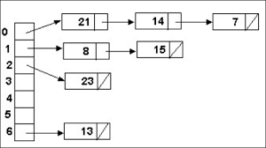
Random Probing-Hashing with Chaining
Allows more than one element to be stored at each position (it is a collision resolution technique)
Each entry in the array A is a pointer to the head of a linked list.
To insert the value x, we simply append it to the list A[x0].
To search for the element x, we perform a linear search in the list A[x0].
To delete the element x, we search for x in the list A[x0] and delete it out.

Slide 19
Random Probing-Hashing with Chaining
Insertions take O(1) time, even in the worst case.
For searching and deletion, the running time is proportional to a constant plus the length of the list stored at A[x0].
Each of the at most n elements not equal to x is stored in A[x0] with probability 1/m, so the expected length of A[x0] is either α = n/m (if x is not contained in the table) or 1 + (n − 1)/m (if x is contained in the table).
Thus, the expected cost of searching for or deleting an element is O(1 + α).
Hashing with chaining supports the set ADT operations in O(1) expected time per operation, as long as the occupancy, α, is a constant.

Slide 20
Random Probing-Hashing with Chaining
The worst-case search time defined as
W = max{length of the list stored at A[i] : 0 ≤ i ≤ m− 1}
The length of each list A[i] is a binomial(n, 1/m) random variable.

Slide 21
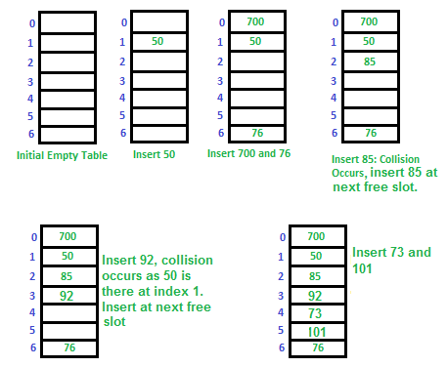
Random Probing-Hashing with Open Addressing
Each table positionA[i] is allowed to store only one value.
When a collision occurs at table position i, one of the two elements involved in the collision must move on to the next element in its probe sequence.
Working of insertion, deletion and search

Slide 22
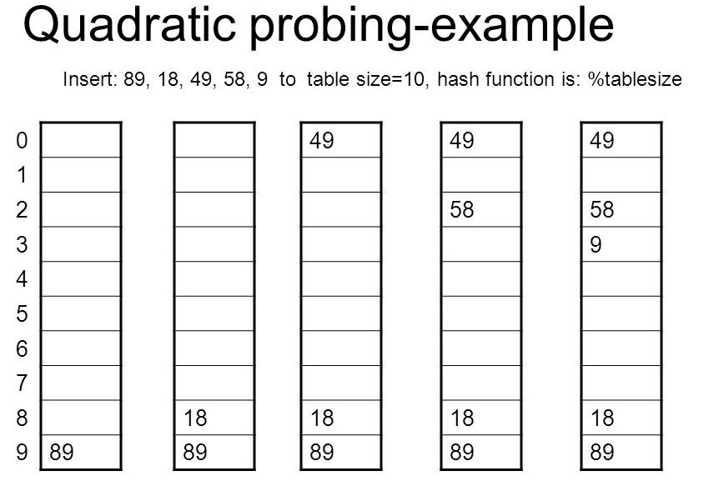
Random Probing-Quadratic Probing

